Slide 1
Agenda
Connecting Calendar, Mail and Contacts
Connecting OneDrive for Business
Connecting SharePoint Sites

Slide 2
Connecting Calendar, Mail, and Contacts

Slide 3
Office 365 APIs for Calendar, Mail and Contacts
Office 365 APIs
Mail Message API
Calendar Events API
Contacts API
Office 365 APIs accessible through REST
https://outlook.office365.com/api/v1.0/Me/Messages
https://outlook.office365.com/api/v1.0/Me/Events
https://outlook.office365.com/api/v1.0/Me/Contacts
Office 365 APIs accessible through OutlookServicesClient
A library which abstracts away sending and receiving REST request

Slide 4
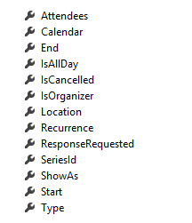
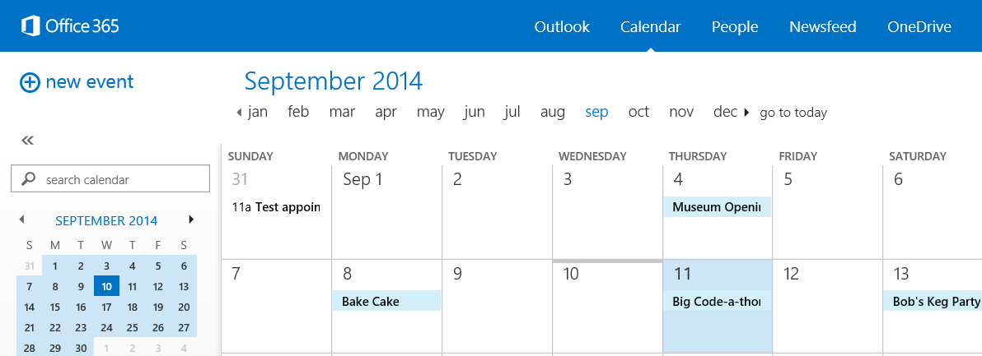
Calendar Events
Common API operations
Reading events for specific date range
Creating events
Deleting events
Editing events
Event

Slide 5
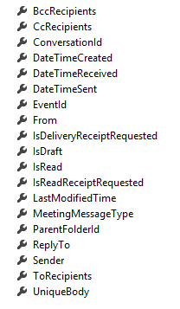
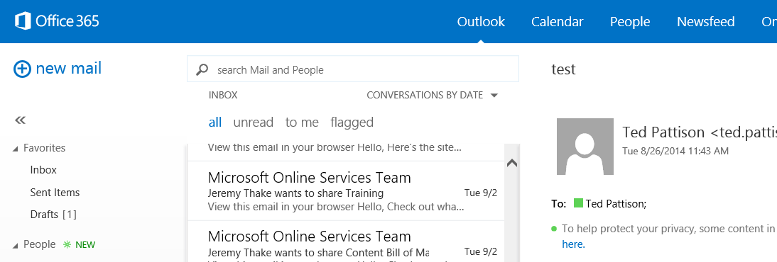
Mail Messages
Message
Common API operations
Reading messages
Deleting messages
Sending messages
Working with attachments

Slide 6
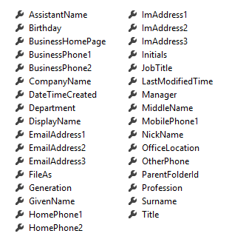
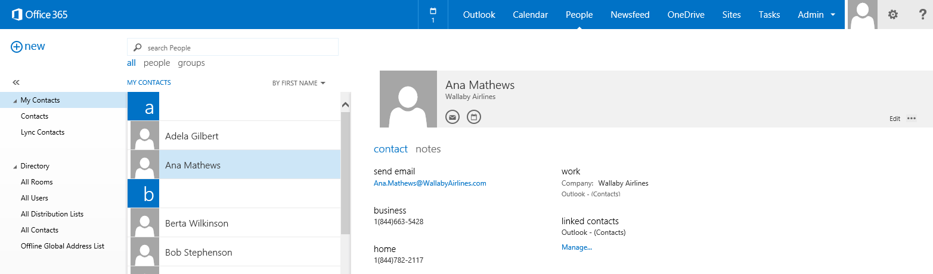
Contacts
Common API operations
Reading contacts
Searching for contacts
Creating contacts
Deleting contacts
Editing events
Contact

Slide 7
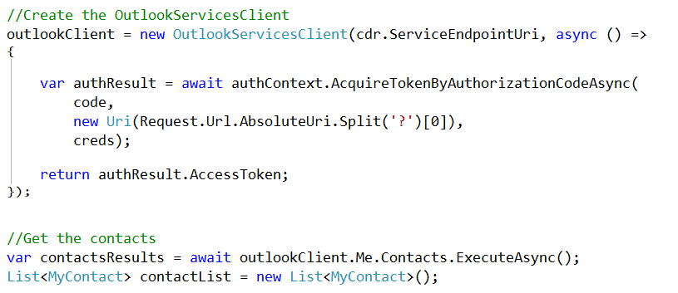
Retrieving Contacts

Slide 8
Exercise 2, Task 6

Slide 9
Connecting OneDrive for Business

Slide 10
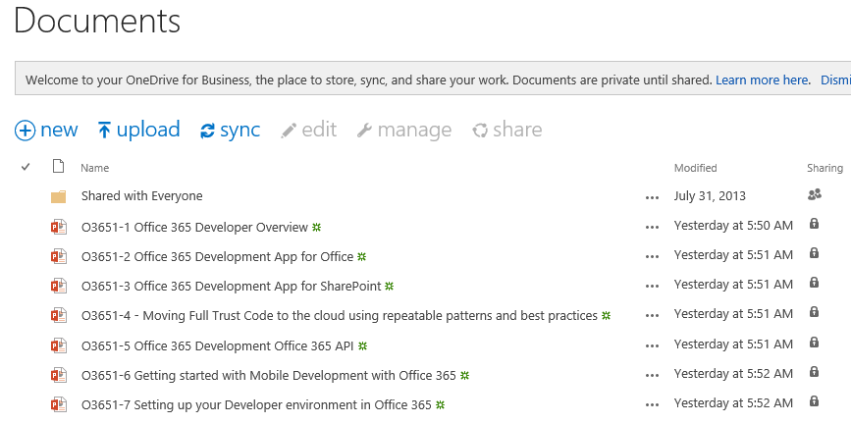
OneDrive for Business
A personal library for storing and organizing your work documents
Notes:
OneDrive for Business is a personal library intended for storing and organizing your work documents. As an integral part of Office 365 or SharePoint Server 2013, OneDrive for Business lets you work within the context of your organization, with features such as direct access to your organization’s address book.
Note OneDrive for Business is different from OneDrive, which is intended for personal storage separate from your workplace. OneDrive for Business is also different from your team site, which is intended for storing team or project-related documents.

Slide 11
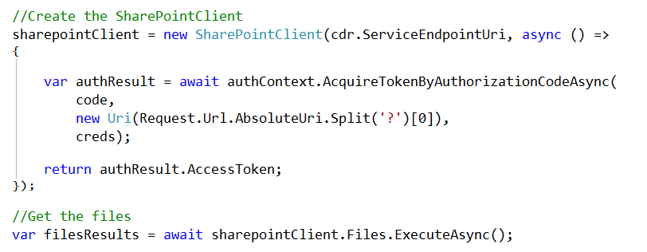
SharePointClient class
Discovery Service discovers “MyFiles” capability
Returns tenant and user-specific URL for user’s OneDrive for Business
SharePointClient.Files abstracts Files API
Notes:
The discovery service discovers the “MyFiles” capability, which will always try to access the OneDrive for Business library

Slide 12
Exercise 2, Task 7

Slide 13
Connecting SharePoint Sites

Slide 14
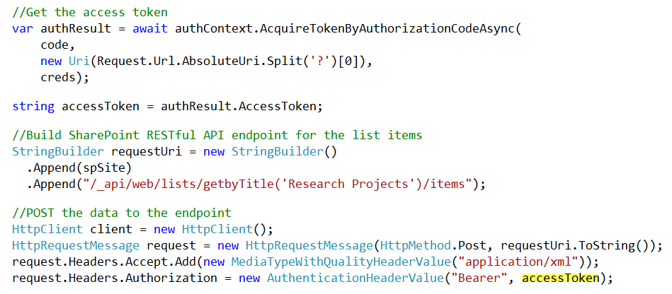
SharePoint Sites
Access the SharePoint REST API with the Access Token

Slide 15
Exercise 2, Task 8

